Slide 1
Bonjour.
Matthieu DELOBELLE Ingenieur Electronique, Projet E-POT

Slide 2
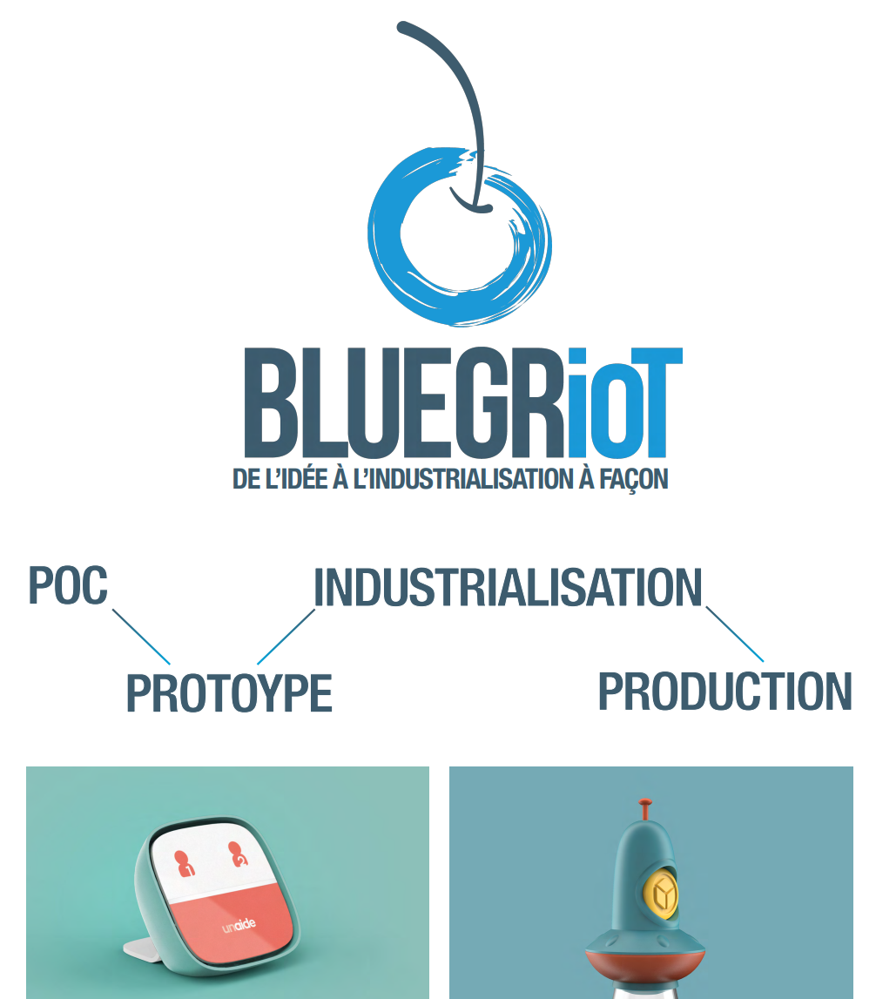

Slide 3
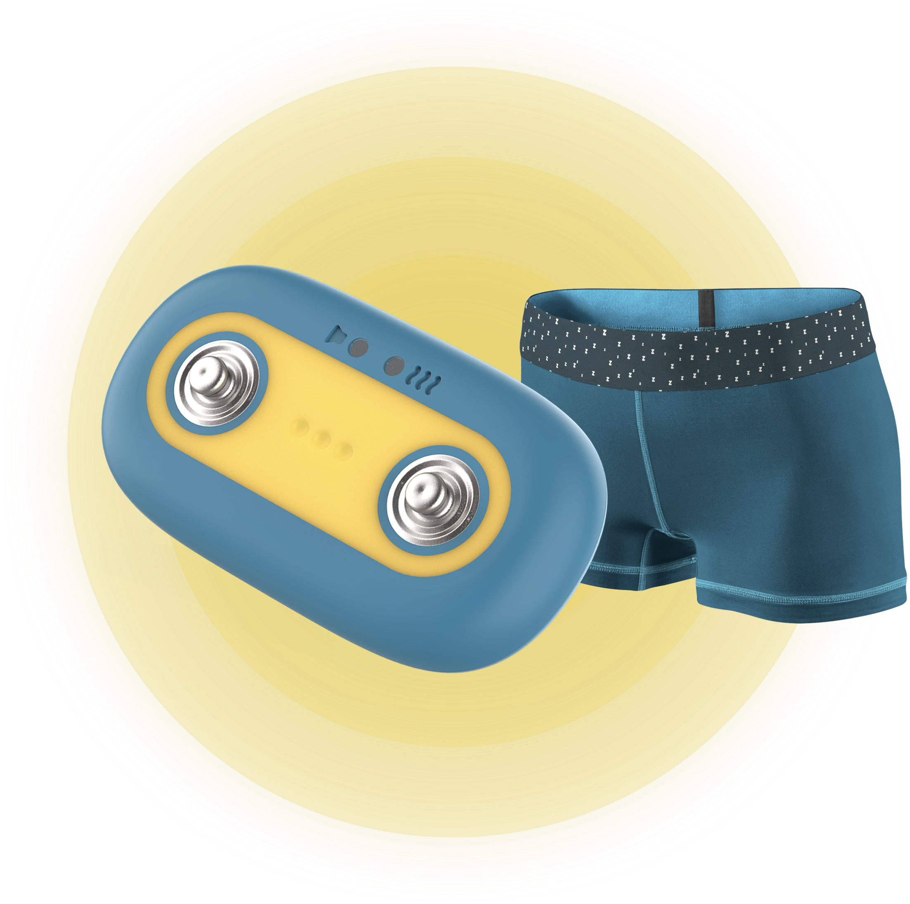
Designed with pediatrician
Invisible
E-POT
15%
BED WETTING
Technical fabric
Comfortable
ENURESIA
Discreet
No waves

Slide 4
E-pot Consortium

Slide 6
